Slide 1
Dark Powder Blue
Presents:
SOFTMATRIX

Slide 2
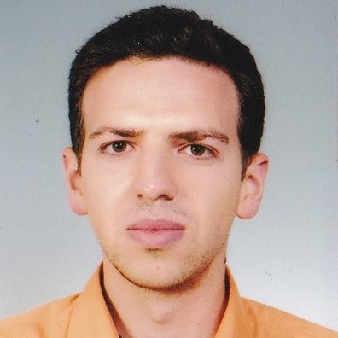
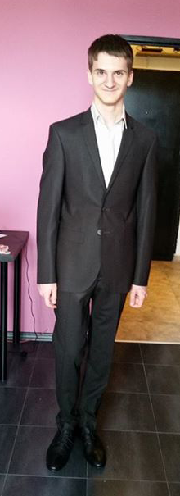
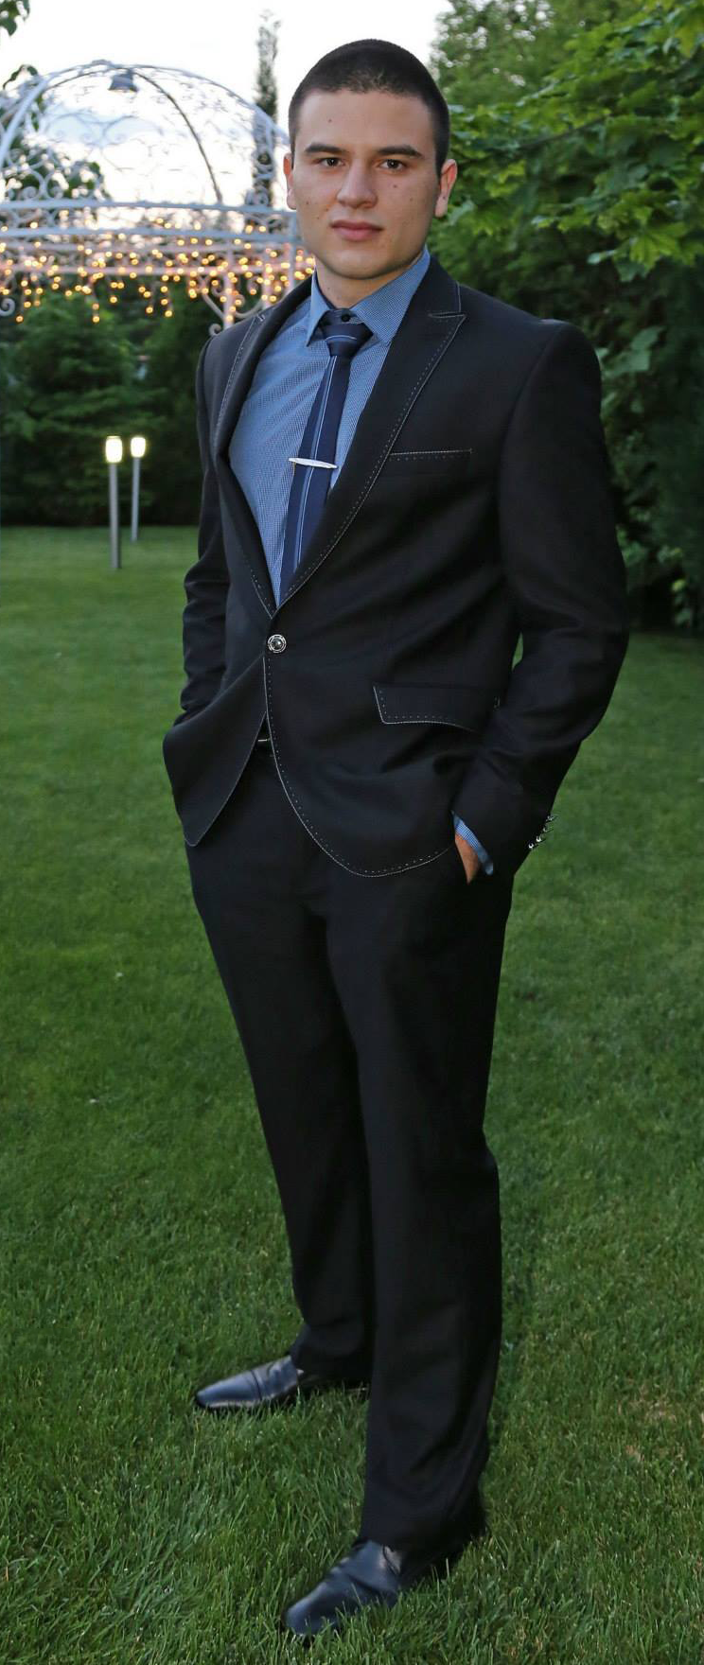
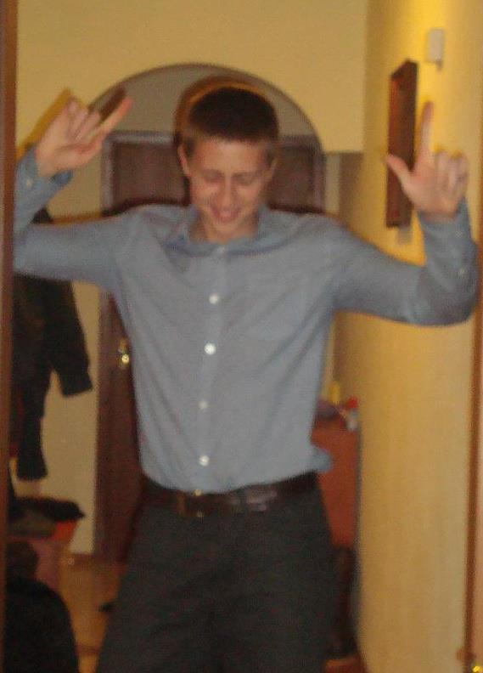
Team members:
Teodor Popov
Plamen Grozdev
Lubomir Yurukov
Plamen Lazarov

Slide 3
Used software:
PhotoShop
Blender 3D
Gimp
Skype
GitHub
WebStorm
Notepad++
Brackets

Slide 4
Live Demonstration

Slide 5
Questions?

